Slide 1
PRARTHANA SAMAJ
SEM- IV
CC-X
MOUSUMI ROY CHOUDHURY

Slide 2
Prarthana Samaj, or "Prayer Society" in Sanskrit, was a movement for religious and social reform in Bombay based on earlier reform movements. Prarthana Samaj was founded by Atmaram Pandurang in 1867 when Kesab Chandra sen visited Maharashtra, with an aim to make people believe in one God and worship only one God.

Slide 3
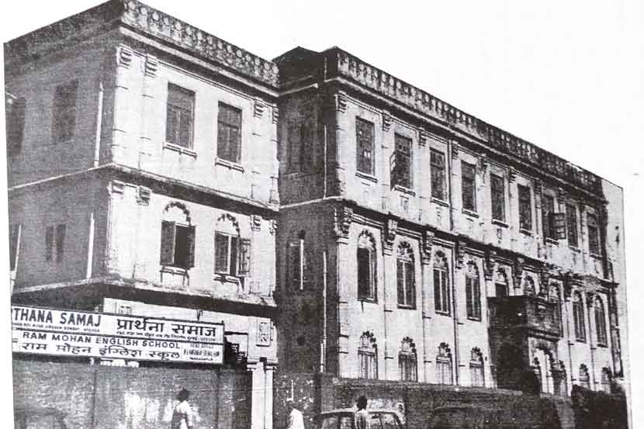

Slide 4
It became popular after Mahadev Govind Ranade joined. The main reformers were the intellectuals who advocated reforms of the social system of the Hindus.It was spread to south India by Telugu reformer, Viresalingam.

Slide 5
The movement was started as a movement for religious and social reform in Maharashtra and can be seen much more alike Brahmo Samaj[]. The precursor of the Prarthana Samaj in Mumbai was the Paramahamsa Sabha, a secret society for the furtherance of liberal ideas by Ram Balkrishna Jaykar and others in Mumbai. It was secret in order to avoid the wrath of the powerful and orthodox elements.

Slide 6
Mahadev Govind Ranade (18 January 1842 - 16 January 1901) was an Indian scholar, social reformer and author. He was a founding member of the Indian National Congressparty and owned several designations as member of the Bombay legislative council, member of the finance committee at the centre, and judge of the Bombay High Court, Maharashtra
As a well known public figure, his personality as a calm and patient optimist influenced his attitude towards dealings with Britain as well as reform in India. During his life he helped to establish the Vaktruttvottejak Sabha, the Poona Sarvajanik Sabha and the Prarthana Samaj, and edited a Bombay Anglo-Marathi daily paper, the Induprakash, founded on his ideology of social and religious reform.

Slide 7
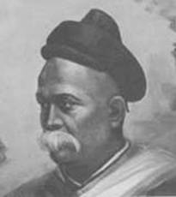
Mahadev Govind Ranade

Slide 8
Bramho samaj was one of the most influential religious movements in India and made a significant contribution to the making of modern India.It was started at Calcutta on 20 August 1828 by Raja Ram Mohan Roy and Debendranath Tagore as reformation of the prevailing Brahmanism of the time (specifically Kulin practices) and began the Bengal Renaissance of the 19th century.

Slide 9
The Brahmo Samaj literally denotes community (Sanskrit: 'samaj') of men who worship Brahman the highest reality. In reality Brahmo Samaj does not discriminate between caste, creed or religion and is an assembly of all sorts and descriptions of people without distinction.

Slide 10
the Prarthana Samaj(ists) were followers of the great religious tradition of the Marathi Sant like Namdev, Tukaram. The Brahmo Samaj founders examined many world religions, including ancient Vedic texts, which subsequently were not accepted to be infallible or divine.

Slide 11
beyond religious concerns, the primary focus of the Prarthana Samaj was on social and cultural reform.

Slide 12
THANK YOU

